Slide 1
Advanced OCR & Handwriting System with Correction

Slide 2
Agenda
01
02
03
Our Team
Introduction
Objective
04
05
06
Related Works
Architecture
Function List
07
08
09
Models & Techniques
Dataset
Application &backend connection
10
11
Demo
Conclusion
2

Slide 3
01
OurTeam
3

Slide 4
01
02
Riham Mohammed Hassan
Rahma Ali Ali Ali
03
04
Mo'men Said Mohammed
Omar Sherif Soliman
06
05
Mohammed Essam Mohammed
Sara Mohammed Abd-Elmonaem
Supervised By
T.A.
Dr. Ahmed Ezzat
Aml Mustafa
4

Slide 5
02
Introduction
5

Slide 6
Optical Character Recognition (OCR) is a transformative technology that converts text from images or scanned documents into machine-readable data. This process enhances efficiency, facilitates data analytics, and integrates seamlessly into modern workflows. OCR plays a crucial role in various industries, such as finance, healthcare, legal, and education, streamlining processes and improving accessibility.
The problem with traditional OCR systems lies in their limitations in recognizing and extracting content from handwritten text. Inaccuracies and misinterpretations often occur without smart correction algorithms. Our goal is to address these challenges by developing an OCR system that demonstrates proficiency in accurately recognizing both printed and handwritten text.
6

Slide 7
03
Objective
7

Slide 8
Developing Ocr and handwritten system with using correction
• Accurate text recognition
• Robust text detection.
• Multi algorithm integration.
• Effiency and speed.
8

Slide 9
04
Related Work
9

Slide 10
Ref.no
Year
Objective
Dataset
Techniques
Accuracy
4
2022
The document provides insights into the datasets used, the techniques employed, and the accuracy achieved in various Document AI tasks.
RVL-CDIP
DiT-B
92.11%
5
Presenting a Convolutional Neural Network (CNN) model for Handwritten Text Recognition, with a focus on English alphabetic and numeric characters
2023
the National Institute of Science and Technology (NIST)
CNN
90.54%
Presenting a The objective of the research is to develop a unified model for incremental multilingual text recognition (IMLTR) that can recognize text instances in different languages.
the Multiplexed Routing Network (MRN),
6
2023
MLT17
78.4%
10

Slide 11
05
System Architecture
11

Slide 12
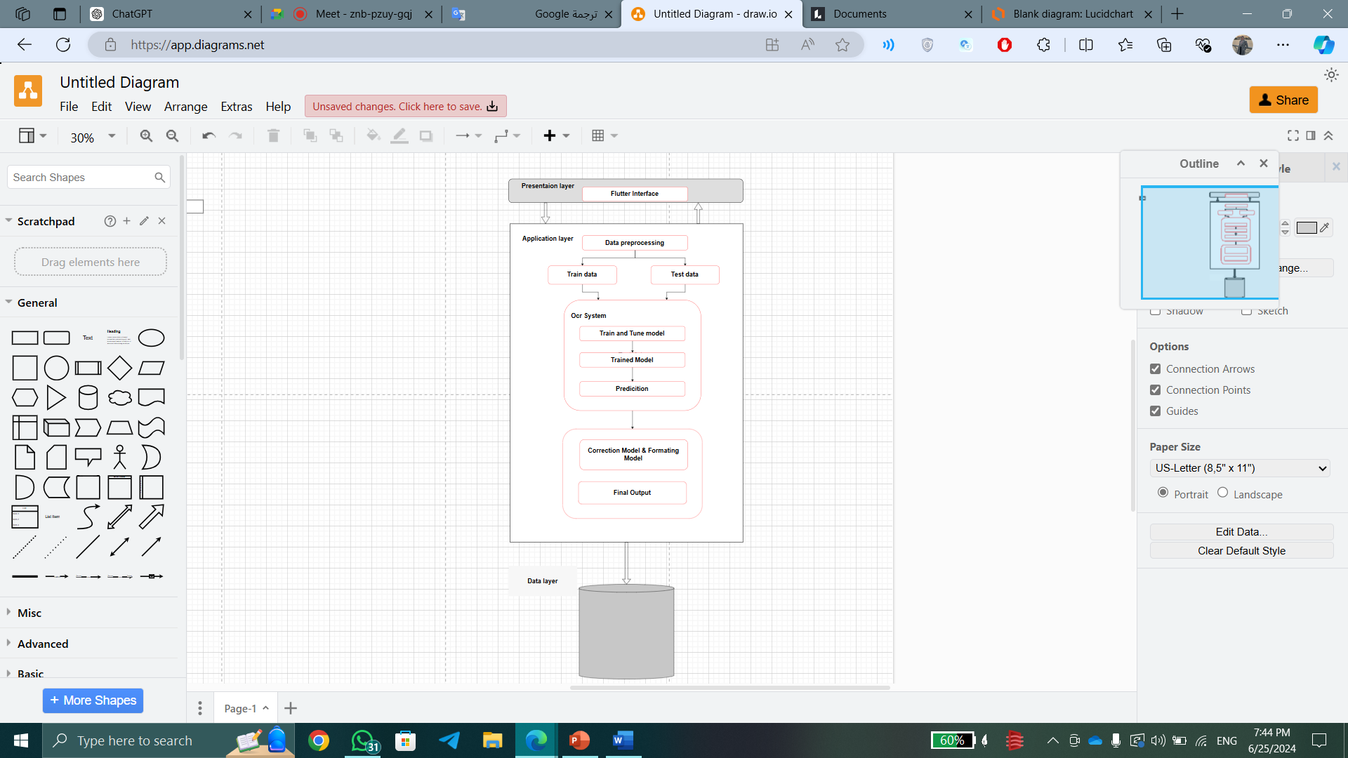

Slide 13
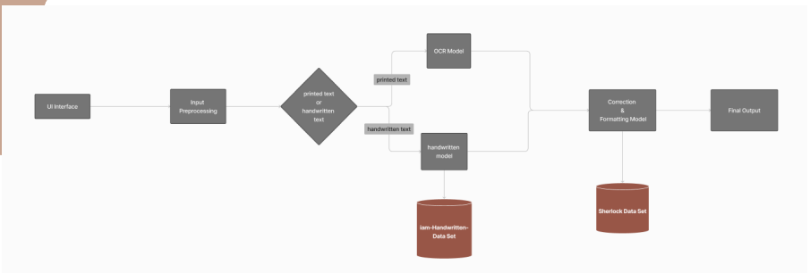

Slide 14
06
Function List
14

Slide 15




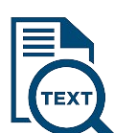
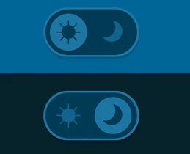
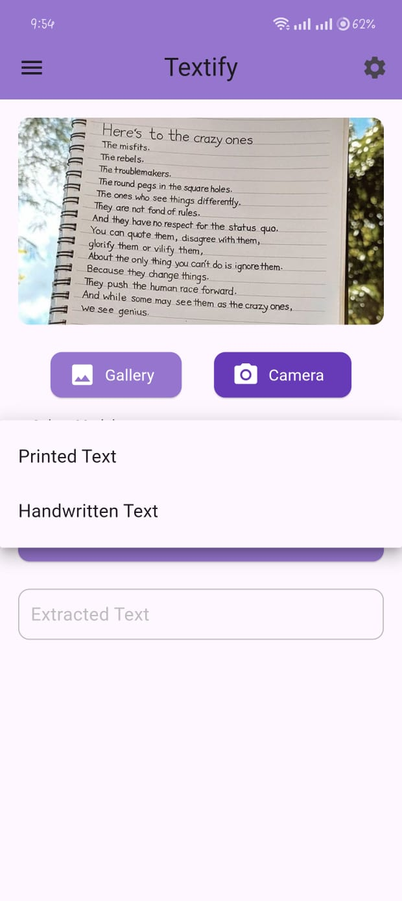
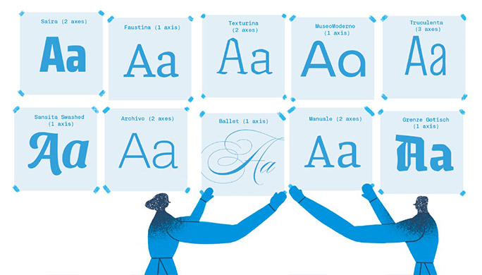


Sign Up & Login
Image Uploud
Take picture
Choose the model
Crop the picture
Text Extraction
Dark Mode
Font family
Font Style
Font Size
15

Slide 16
07
Models & Techniques
16

Slide 17
• Handwritten Model
• Correction Model
• OCR Model
17

Slide 18
OCR Model
18

Slide 19
Today, we explore the groundbreaking realm of Optical Character Recognition (OCR)
OCR models serve as the bridge between the physical and digital worlds. They effortlessly convert printed text into editable and searchable digital content, making data extraction and document processing.
the tools and methods we use to extract text play a crucial role in delivering a seamless user experience.we'll explore some of the most popular and effective extracting methods used in text processing.
1. OpenCV2
2.Numpy
3.Pytesseract
4.EAST
19

Slide 20
1-OpenCV2
OpenCV2 (Open Source Computer Vision Library) is a versatile open-source library designed for real-time image processing and computer vision. Widely used in OCR (Optical Character Recognition) applications, Real-time image and video processing, feature detection for pattern recognition, seamless cross-platform compatibility, and integration with machine learning frameworks like TensorFlow and PyTorch.
OpenCV2 provides robust tools for image and video processing, making it a go-to choice for tasks like character detection, text extraction, and document analysis. With support for multiple programming languages, machine learning integration, and cross-platform compatibility, OpenCV2 is a powerful resource for developing efficient OCR solutions.
-Usage
1. Loading Model
2. Running Model
3. Applying rotated bounding boxes and NMS
20

Slide 21


4. Applying Image preprocessing ( thresholding, Gaussian Blur, Grayscale)
21

Slide 22

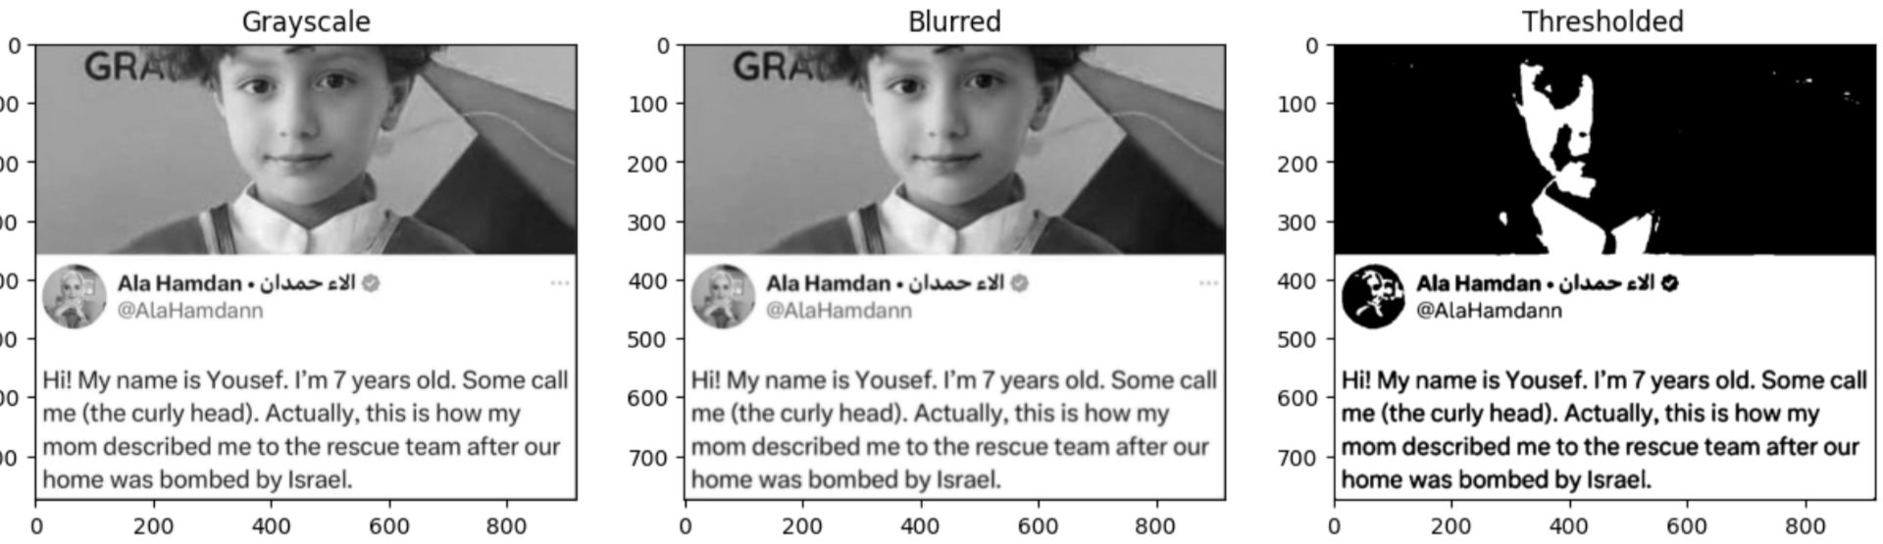
22

Slide 23


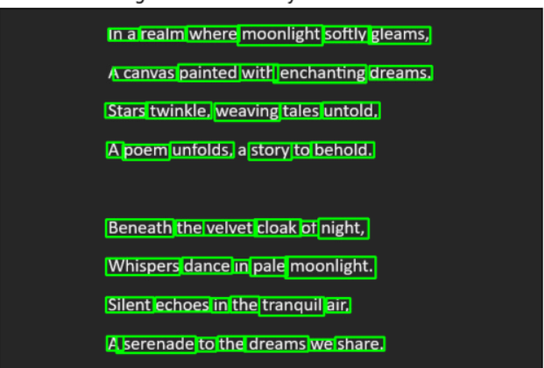
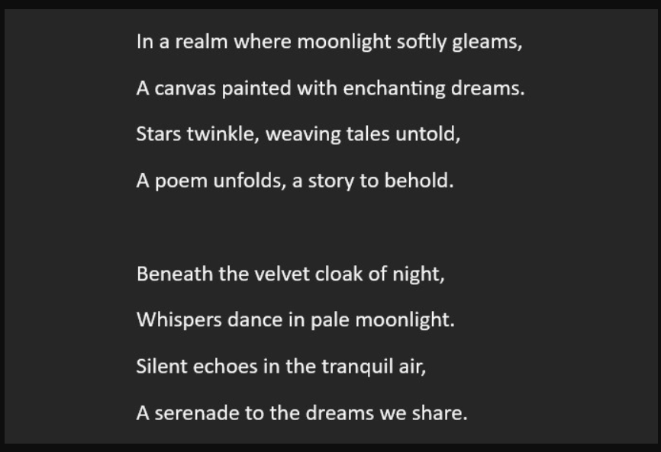
5. Drawing detected bounding boxes using OpenCV2:
23

Slide 24
2-Numpy
NumPy, or Numerical Python, plays a pivotal role in OCR applications by facilitating efficient handling and manipulation of numerical data, particularly in image processing tasks. Its array and matrix operations are instrumental in processing pixel data, enabling the extraction and analysis of text from images. NumPy's mathematical functions enhance the accuracy of OCR algorithms by providing a robust foundation for computations involved in text recognition, character segmentation, and other image processing tasks. Its seamless integration with image processing libraries and tools makes NumPy a fundamental component in the development of OCR solutions, contributing to the precision and efficiency of text extraction from image
-Usage
1. Creating images arrays
2. array operations to create a blob that’s used as an input for the model
3. Image arrays preprocessing
24

Slide 25
3- Pytesseract
Pytesseract is a Python OCR tool leveraging Google's Tesseract-OCR Engine. Tailored for Optical Character Recognition, it excels in converting text within images into machine-readable formats. Key features include open-source accessibility, language versatility, seamless Python integration, and configurable settings. Pytesseract finds applications in document processing, data extraction, and automation, supported by an active community for ongoing enhancements. In the realm of OCR, Pytesseract stands as a versatile, user-friendly solution for extracting valuable text information from diverse sources.
-Usage
1-Text extraction
25

Slide 26
4-EAST Model
The EAST (Efficient and Accurate Scene Text) model is a deep learning model designed for efficiently and accurately detecting text in natural scene images. It predicts the geometry (bounding box and rotation angle) and a confidence score for each text region, and it utilizes non-maximum suppression for post-processing. The EAST model is widely used for tasks like scene text recognition and document analysis due to its effectiveness and efficiency.
Architecture
The EAST model architecture is based on a deep neural network that combines feature extraction, geometry prediction, and score prediction. The network is designed to process an entire image in a single forward pass.
26

Slide 27
Usage
1-Geometry Prediction: predicts the geometry of text regions, including the bounding box coordinates and the rotation angle of the text.
2-Score Prediction: predicts a confidence score for each detected text region, indicating the likelihood that the region contains text.
3-Non-Maximum Suppression (NMS): After the predictions are made, a post-processing step involves applying non-maximum suppression to remove redundant and overlapping bounding boxes, improving the precision of the detected text regions.
4-Detect Text Regions
27

Slide 28
Why EAST?
Efficiency:
The EAST model is designed to be efficient, enabling real-time or near-real-time text detection.
Its architecture allows for processing entire images in a single forward pass, contributing to its computational efficiency.
Accuracy:
Despite its efficiency, the EAST model maintains a high level of accuracy in text detection.
It provides accurate results in detecting text regions, even in challenging scenarios with varying text orientations and sizes.
28

Slide 29
Why EAST?
Rotation Handling:
The EAST model is capable of handling rotated text, which is important in scenes where text may appear at different angles.
Its geometry prediction includes information about the rotation angle of the text, making it suitable for scenarios with non-horizontal text.
Scene Text Recognition:
While the primary focus of the EAST model is text detection, it also provides information about the geometry of the detected text regions.
This additional information can be valuable for subsequent tasks like scene text recognition.
29

Slide 30
Handwritten Model
30

Slide 31
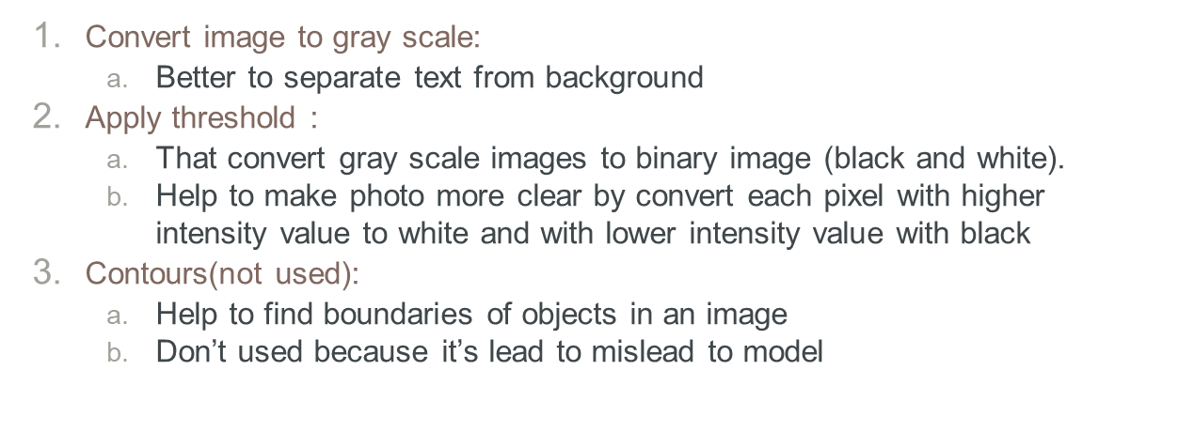
Preprocessing on Handwritten images
31

Slide 32
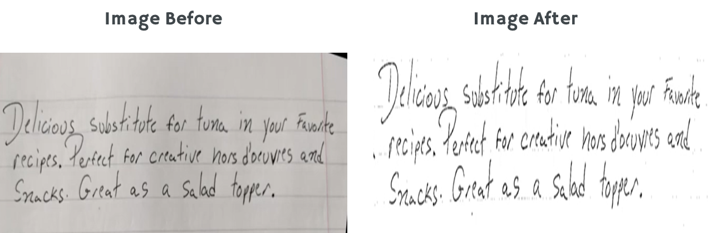
Before VS After Preprocessing
32

Slide 33
Models
Handwritten models is used to transfer textual image to text that will be used in correction model
kinds:
Pytesseract
Keras-OCR
Easy-OCR
Merge between pytesseract and Keras-OCR
33

Slide 34
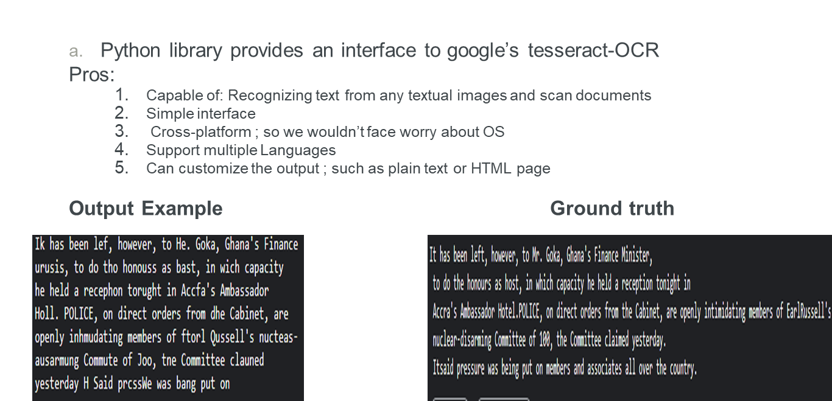
1- Pytesseract Handwritten model
34

Slide 35
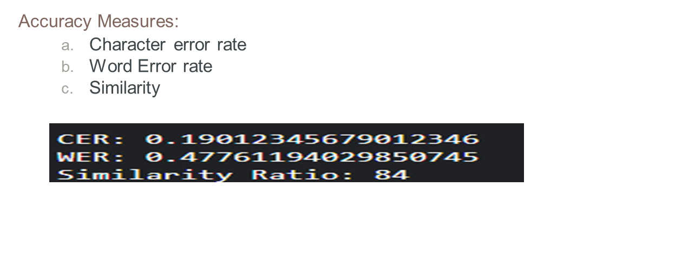
35

Slide 36
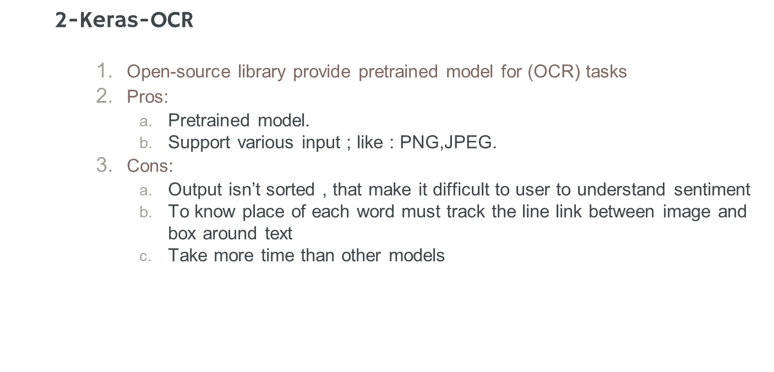
36

Slide 37
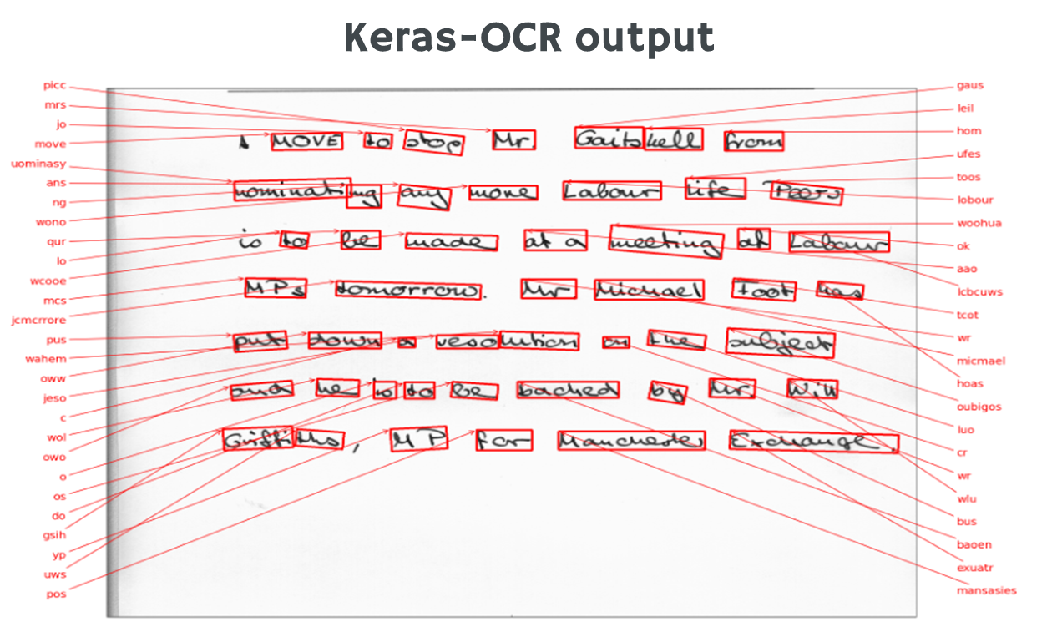
37

Slide 38
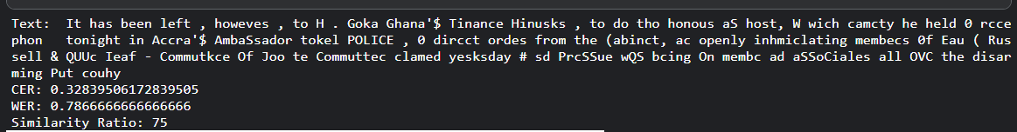
3-Easy-OCR
Pros:
Multi-language
Cross platform
Efficient performance
Cons:
Less efficient than pytesseract
Must specify the language before
Accuracy output:
38

Slide 39
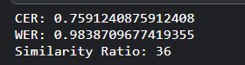
4-Merge between Keras and pytesseract
In operation to increase similarity and reduce character error rate try to merge between keras and pytesseract by apply keras first and then pytesseract and replace similar text from pytesseract to keras:
Accuracy:
39

Slide 40
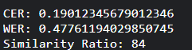
Why Pytesseract..?
The least CER,Highest Similarity Ratio.
Sorted output like original text.
Support multiple Languages.
Can customize the output ; such as plain text or HTML page.
More efficient and accurate.
40

Slide 41
Correction Model
41

Slide 42
Correction model
In the realm of text processing and natural language understanding, ensuring the accuracy and clarity of textual content is paramount. Whether it's a simple spell check or a more complex task like sentiment analysis, the tools and methods we use to correct text play a crucial role in delivering a seamless user experience. In this article, we'll explore some of the most popular and effective correction methods used in text processing.
1. PySpellChecker
2.TextBlob
3.Spello
4.custom models
5.JamSpell
6.SymSpell
42

Slide 43
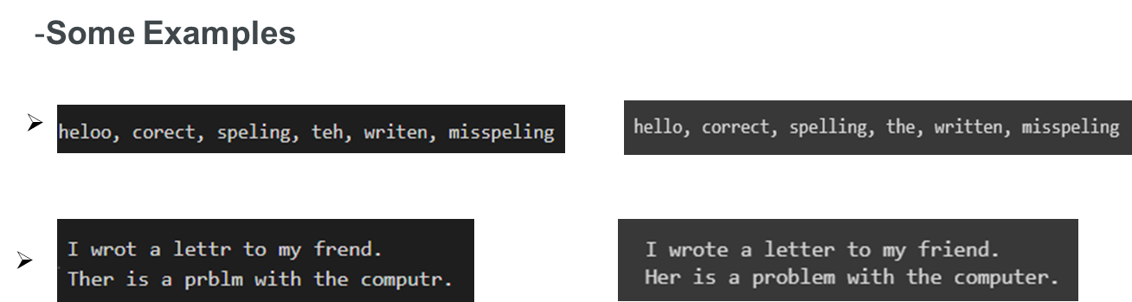
1- Text Blob
TextBlob is a Python library for processing textual data. It provides a simple API for common natural language processing (NLP) tasks such as part-of-speech tagging, noun phrase extraction, sentiment analysis, classification, translation, and more. TextBlob is built on top of NLTK and Pattern, two other popular NLP libraries for Python.
TextBlob object uses a simple spelling correction algorithm based on word frequencies in the English language. It may not always produce perfect results, especially for words that are not in the English dictionary or for words that are spelled correctly but used incorrectly in the context of the text
43

Slide 44
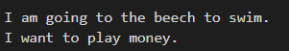
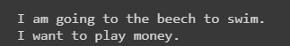
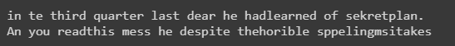
.
.
Conclusion:
TextBlob is a powerful tool for text processing, particularly for tasks like spell checking and correction. However, like any tool, it has its limitations. One of these limitations is its ability to handle context-based errors, TextBlob's spell checking and correction capabilities are primarily based on dictionary lookups and language-specific rules. It may struggle with context-based errors because it does not have a deep understanding of the context in which the text is used
44

Slide 45
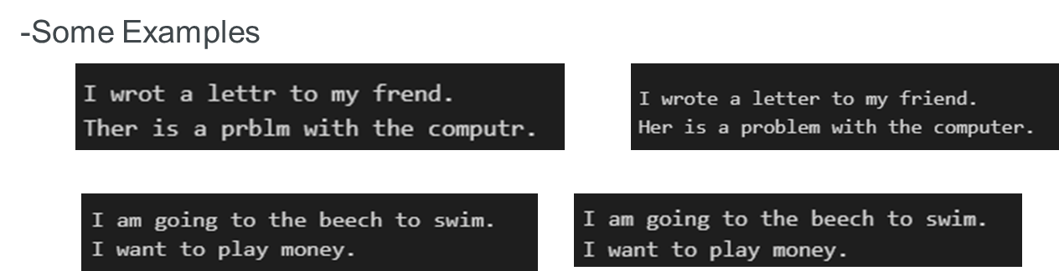
2- PySpellChecker
-The pyspellchecker library is a Python package that provides a simple and efficient way to perform spelling correction. It is built on top of the hunspell library, which is a widely used and highly accurate spell-checking library. The pyspellchecker library provides a SpellChecker class that can be used to find and correct misspelled words in a given text.
-SpellChecker class from the pyspellchecker library uses a simple spelling correction algorithm based on word frequencies in the English language. It may not always produce perfect results, especially for words that are not in the English dictionary or for words that are spelled correctly but used incorrectly in the context of the text.
45

Slide 46
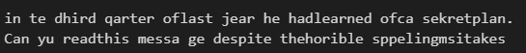
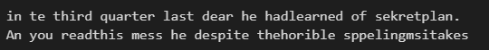
Conclusion:
Both PySpellChecker and TextBlob are useful tools for spell correction, and they often provide similar outputs for misspelled words, However, both PySpellChecker and TextBlob are useful for spell correction and often provide similar outputs for misspelled words, they may struggle with context-based errors and missing spaces.
46

Slide 47
3 -Spello Library
- The Spello library is a Python package designed for spell correction and text normalization. It is built on top of the PyTorch library and uses deep learning techniques to achieve its functionality. The library is designed to be easy to use and can be integrated into various natural language processing (NLP) pipelines.
- The Spello library uses context to make corrections. It employs deep learning techniques, specifically recurrent neural networks (RNNs), to learn patterns and relationships between correctly spelled words and their misspelled versions. This allows the model to take into account the surrounding words and context when making corrections.
- After training the Spello model on a dataset of Sherlock Holmes novels, we aim to leverage its contextual understanding to make corrections that are more accurate and contextually appropriate.
47

Slide 48
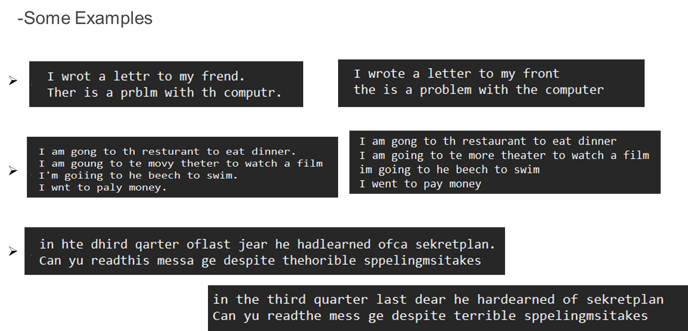
48

Slide 49
Conclusion:
The Spello model demonstrates strong performance in correcting misspelled words and sentences that do not rely heavily on context, However, when it comes to context-based corrections, the model's performance is not as robust. While it does show improvement in this area, the output may not always be optimal. This is because understanding context is a more complex task that requires a deeper understanding of language nuances and the intended meaning of the text. While the Spello model has been trained on a dataset of Sherlock Holmes novels to improve its contextual understanding, it may still struggle with certain nuances and subtleties of language.
49

Slide 50
4- Custom model
- We trying to implement a spelling correction system utilizing recurrent neural network (RNN) and Long Short-Term Memory (LSTM) architectures. These architectures are crucial for understanding and predicting sequences of words, making them well-suited for tasks like language modeling and correction. The system first loads a pre-trained language model capable of predicting the next word in a sequence based on both preceding and succeeding words. This model utilizes bidirectional LSTMs to capture contextual information effectively.
- Overall, the system aims to enhance text accuracy by offering correction suggestions based on learned patterns and linguistic insights. By combining RNN and LSTM architectures with advanced linguistic techniques, it strives to provide effective spelling correction capabilities for various text inputs.
50

Slide 51
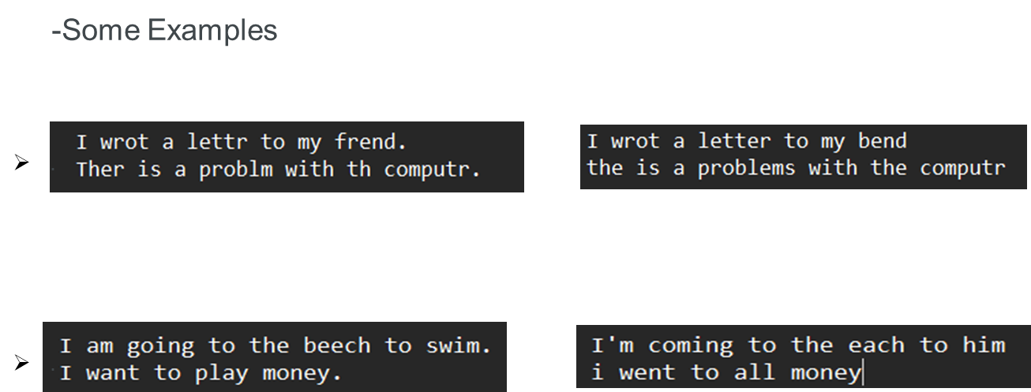
51

Slide 52
Conclusion:
-Our attempt to utilize the custom model for text correction based on contextual cues yielded suboptimal performance. This was primarily attributed to the absence of a sufficiently generalized dataset encompassing diverse fields of language usage. Additionally, resource constraints necessitated a reduction in the model's complexity, including lowering the number of units, vocabulary size, and the amount of available data. Despite these adjustments, the model struggled to achieve desired levels of accuracy, highlighting the importance of comprehensive datasets and computational resources for effectively training and deploying such systems.
52

Slide 53
5- Jamspell model
-JamSpell is a Python library for spell checking and correction, built on the widely used Hunspell library. While primarily statistical in nature, it leverages various techniques to suggest contextually appropriate corrections. Firstly, it utilizes a language model trained on a large corpus of text to calculate the probability of a word being correct in a given context. Additionally, it employs the Levenshtein distance to measure similarity between words, enabling it to suggest corrections even for non-exact matches. Furthermore, JamSpell can utilize phonetic similarity to suggest corrections based on sound rather than spelling. Although lacking deep contextual understanding, it can use surrounding words in a sentence to make more informed corrections. These capabilities collectively enhance its spell-checking accuracy, despite its reliance on statistical probabilities and patterns in language.
53

Slide 54
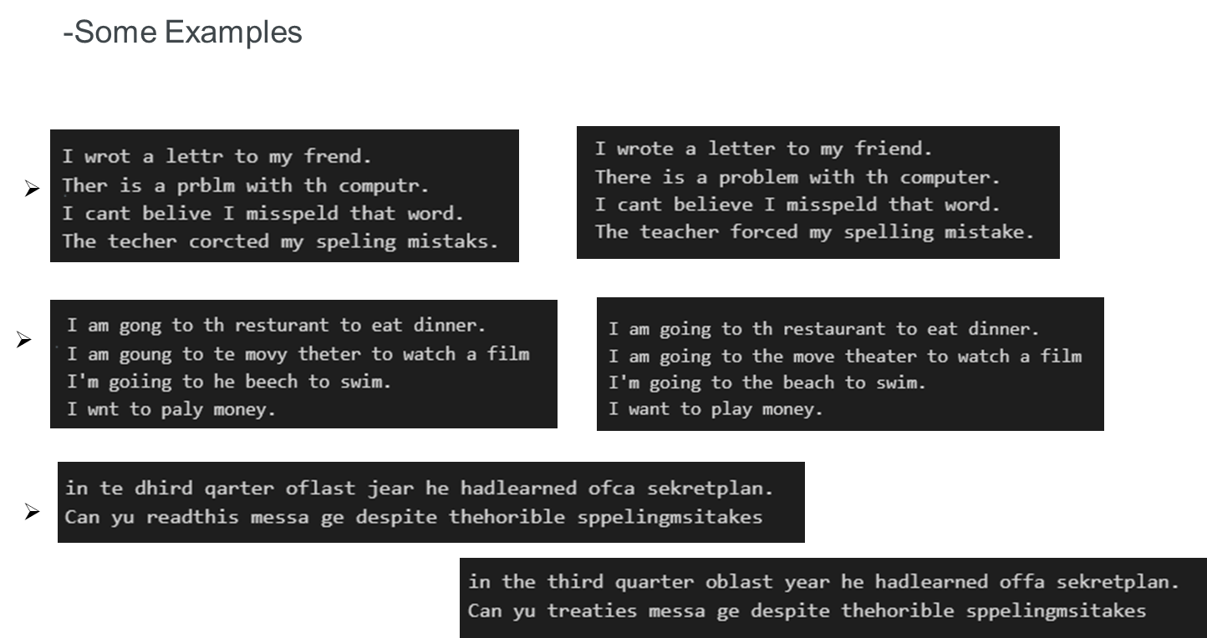
54

Slide 55
Conclusion:
- JamSpell demonstrates a stronger ability to make corrections in sentences that rely on context compared to Spello. However, both models still face challenges when dealing with complex sentences or text that contains multiple errors.
While JamSpell's language model, edit distance, phonetic similarity, and ability to use contextual information provide it with an advantage in making contextually appropriate corrections, it is important to note that no model is perfect. Both Spello and JamSpell have their limitations and may not always produce the desired output, especially when dealing with complex sentences or text that contains multiple errors.
55

Slide 56
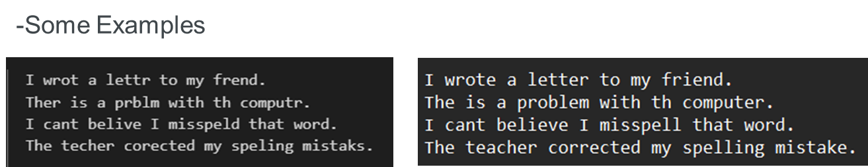
6- Symspell
- SymSpell is a Python library for spell checking and correction. It uses the Symmetric Delete spelling correction algorithm, which is highly efficient and accurate. The library provides a SymSpell class with methods for looking up words and compound words in the dictionary and getting suggestions for correcting their spelling. The suggestions are based on the frequency of the words in the dictionary and the edit distance between the misspelled word and the correct word.
- SymSpell uses the LookupCompound function to perform compound-aware automatic spelling correction of multi-word input strings. This function is designed to handle various types of errors that can occur in compound words, including splitting errors, concatenation errors, substitution errors, transposition errors, deletion errors, and insertion errors. It is particularly useful for languages where compound words are common and can be challenging to correct.
56

Slide 57
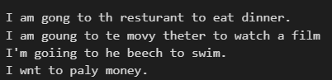
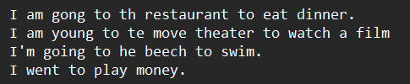
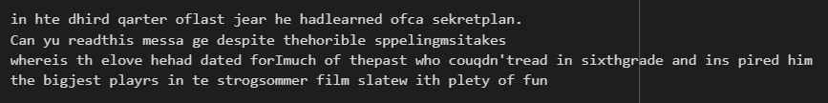
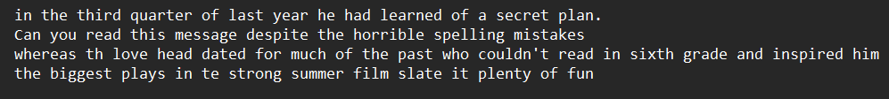
.
.
57

Slide 58
Conclusion:
- SymSpell is a robust spelling correction algorithm renowned for its proficiency in correcting both individual words and entire sentences, especially adept at handling compound words and detecting spacing errors. However, for context-dependent corrections, JamSpell may offer advantages due to its utilization of language models to gauge word correctness within context, enabling more contextually relevant suggestions. JamSpell further leverages phonetic similarity and contextual cues for improved correction accuracy. While SymSpell excels in general word and sentence corrections, JamSpell's contextual approach may be preferable for tasks heavily reliant on context. Ultimately, the choice between them hinges on the specific needs of the text processing task.
58

Slide 59
- The combination of SymSpell, JamSpell, and Pyspellchecker :
The combination of SymSpell, JamSpell, and Pyspellchecker can provide a comprehensive approach to text correction, leveraging the strengths of each technique to address different types of errors. Here's how the combination could work:
SymSpell: Use SymSpell first to address errors where a space has been mistakenly inserted within a correct word, leading to two incorrect terms, or where a space has been mistakenly omitted between two correct words, leading to one incorrect combined term. SymSpell's compound-aware automatic spelling correction capabilities make it well-suited for this task.
JamSpell: Next, use JamSpell to address context-based errors. JamSpell's language model, edit distance, phonetic similarity, and ability to use contextual information can help make more contextually appropriate corrections.
Pyspellchecker: Finally, use Pyspellchecker to ensure the individual words are correct. Pyspellchecker's spell-checking capabilities can help catch any remaining spelling errors that SymSpell and JamSpell may have missed.
By combining these techniques, you can create a more robust and accurate text correction system that can handle a wide range of errors, from simple spelling mistakes to more complex context-based errors.
59

Slide 60
08
Datasets
60

Slide 61
We gathered diverse datasets of printed and handwritten documents from several reputable sources to train and evaluate our models effectively.
Sites and Sources
MNIST Database: A widely used database for handwritten digits, providing a foundational dataset for training handwritten recognition models.
COCO Text Dataset: A dataset containing complex scenes with dense text annotations, used to train our scene text recognition models.
IAM Handwriting Database: A collection of handwritten English text samples, including forms, letters, and historical documents, used to train and test handwritten text recognition.
Synthetic Data Generation: Additionally, synthetic datasets were generated using tools like Python scripting and augmentation techniques to diversify the training data and improve model generalization.
These datasets were selected for their diversity, ensuring our system's robustness across different text recognition tasks.
61

Slide 62
09
Application & backend connection
62

Slide 63
We began by developing two backend files:
- Handwritten
- Correction
To transform these backends into APIs accessible to a Flutter application we opted for the Flask framework.
Using Flask for API Development :
Flask: a micro web framework for Python, facilitated the conversion of our backend logic into RESTful APIs. This allowed us to expose functionalities such as text processing and correction through HTTP endpoints.
Integrating NGROK for Local Server Access:
To enable external access during development, we utilized NGROK. NGROK provided a secure way to expose our local Flask server to the internet, generating a temporary public URL (BaseURL) for our application to interact with the APIs.
Benefits for Flutter Development
Simplified Backend Interaction
Efficient Testing
Scalability and Maintenance
In summary, our approach involved converting handwritten backend scripts into Flask APIs and using NGROK to provide a secure and accessible local development environment. This setup supports efficient integration of backend functionalities into Flutter applications, enhancing overall development agility and scalability.
63

Slide 64
10
Demo
64

Slide 65
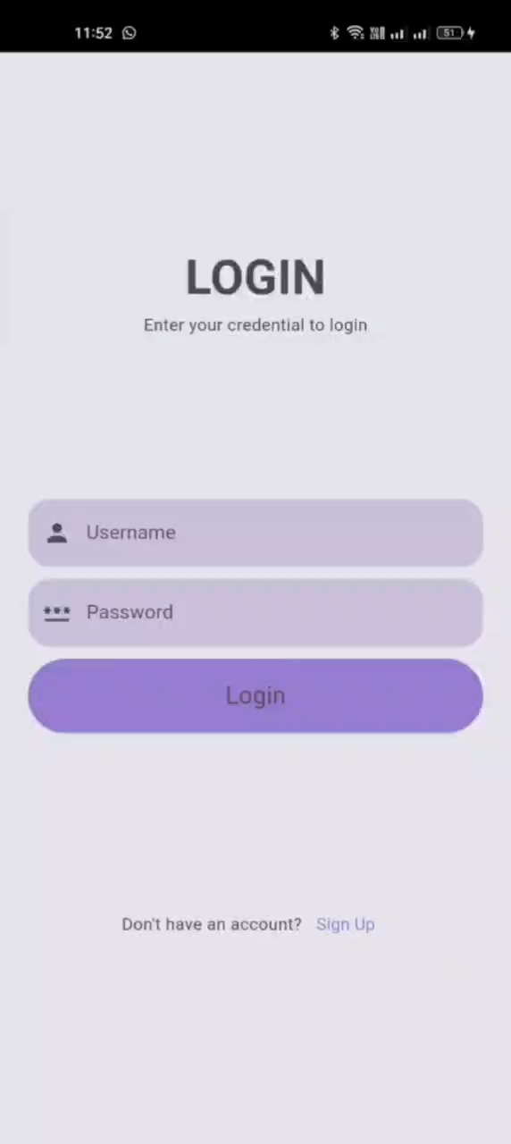
65

Slide 66
11
Conclusion
66

Slide 67
Advanced OCR (Optical Character Recognition) and handwritten text recognition systems are transformative, significantly impacting society. They convert printed and handwritten content into accessible digital formats, aiding individuals with visual impairments or language barriers, and streamline operational processes across industries, enhancing efficiency.
Culturally, OCR technology preserves heritage by digitizing manuscripts and records, making them accessible for future generations. In machine learning and AI, OCR provides essential datasets for training algorithms, spurring innovation across various fields.
For businesses, OCR improves operational efficiency, customer service, and workflows, while in education, it democratizes knowledge by digitizing educational materials, supporting students with disabilities.
Overall, advanced OCR and handwritten text recognition systems enhance accessibility, preserve cultural heritage, foster innovation, and support educational and business needs, promising a more connected and optimized future
67

Slide 68
So, What’s Next?
68

Slide 69
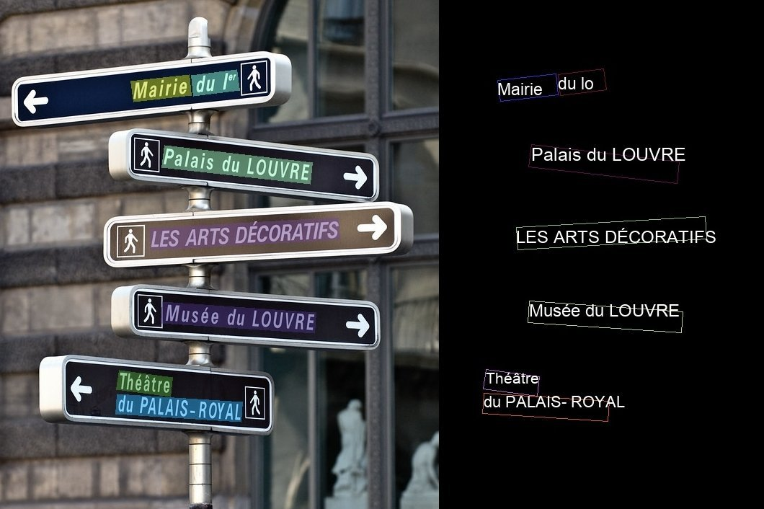
Augmented Reality Integration
Vision: Enhance user experience with real-time text detection using AR.
How: Overlay detected text directly on real-world objects through the camera.
69

Slide 70
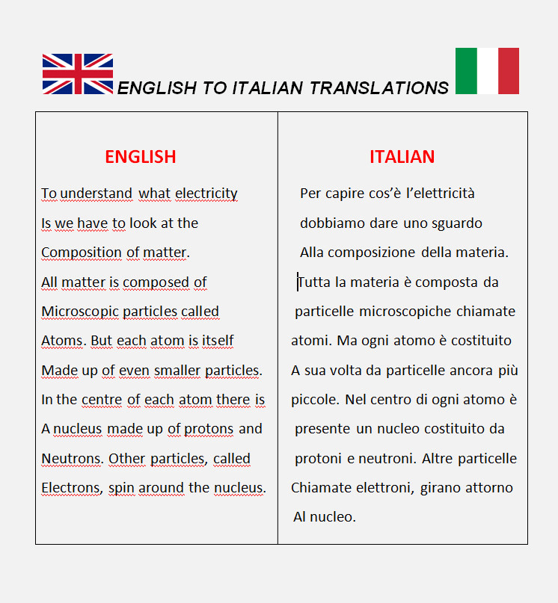
2. Multilingual Text Translation
Vision: Break language barriers by translating detected text into multiple languages.
How: Use advanced translation APIs to provide instant translations.
70

Slide 71

. Text-to-Speech Conversion
Vision: Make the app more accessible by converting translated text to audio.
How: Integrate text-to-speech functionality to read out the translated text in different languages
71

Slide 72
Thanks!
Do you have any questions?
72

